Slide 1
Exoplanets Project
Zachary Cohen, Dechong Wang, John Wright

Slide 2
Motivation
What can we learn about planets orbiting other stars?
We can estimate exoplanet sizes by analyzing fluctuations in light levels of their stars
This is called the transit method
We want to apply this method

Slide 3
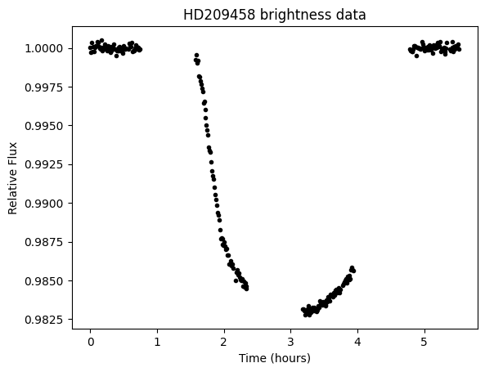
Methods
Star: HD209458
Brightness data from NASA exoplanets archive

Slide 4

Methods
Fit a box model:
Using Bayesian methods.

Slide 5

Methods
Our estimate of delta then allows us to estimate the size of the planet via the equation

Slide 6
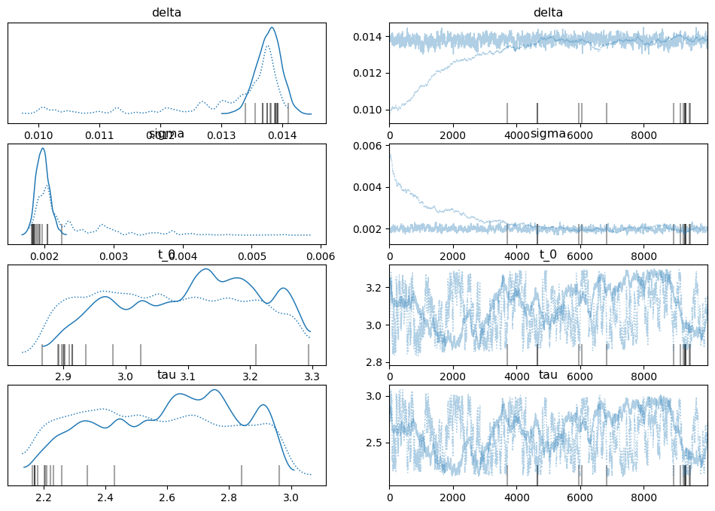
Results
Posterior means (approximate)
delta : 0.014
t_0: 3.1
tau : 2.7
(sqrt(delta) approx 0.12)

Slide 7
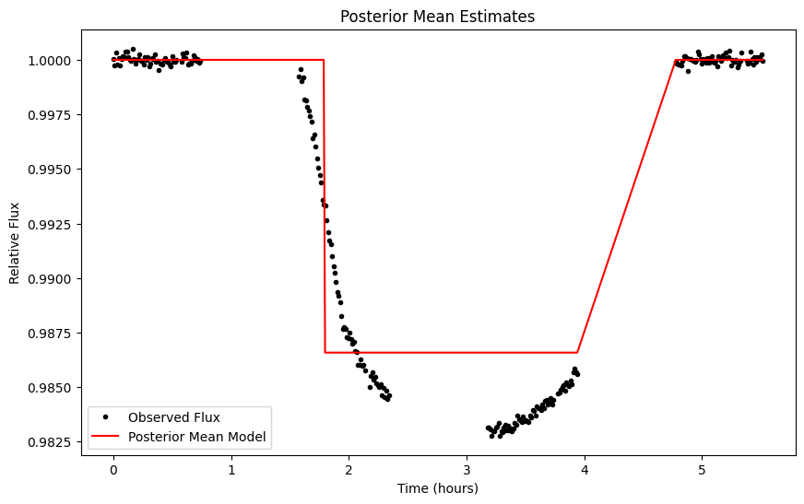
Results
Model using posterior mean estimates.

Slide 8
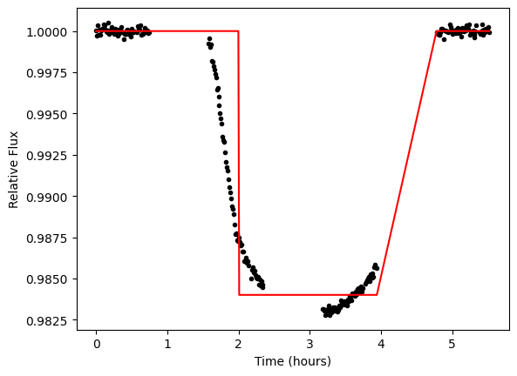
Results
This model might look better visually, but it has a reduced chi-squared statistic of about twice the previous model (2.3 vs 1.1)

Slide 9
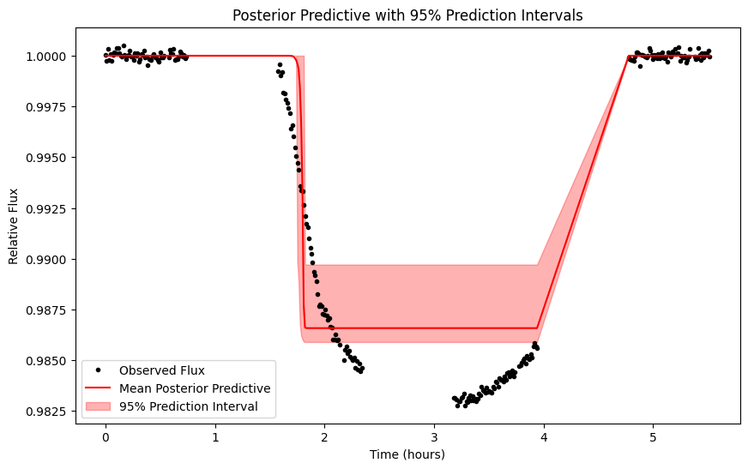
Results: Posterior Predictive Distribution

Slide 10
Conclusion
The transit method is an efficient way to locate exoplanets, while also determining other data such as the planet’s size.
Using observed data of the planet, HD 209458 b, it is possible to determine the flux dip visually, representing the amount of light blocked by the planet over a set interval.
The box model is not perfect
The planet we observed probably had a radius about 12% of that of its sun

Slide 11
References
https://exoplanetarchive.ipac.caltech.edu/overview/HD209458

Slide 12
AI Statement
AI was used to generate posterior predictive plots, but not otherwise.

Slide 13
Contribution Statement
Individual Contributions:
John Wright used his code to complete the “Motivation”, “Methods”, and “Results” slides
Dechong Wang wrote the “References” slide
Zachary Cohen wrote the “Conclusion”, “AI Statement”, “Contribution Statement”, and “References” slides

